Slide 1


SHAPE OPTIMISATION OF A WINGTIP FOR DRAG REDUCTION
Antoine CORNILLOT, Alessia GARIBALDI, Tariq IFRIQI, Flora MERCAT, Marc PIERRE

Slide 2
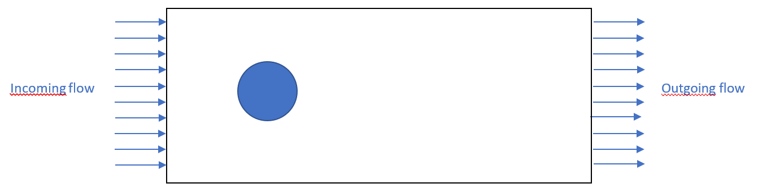
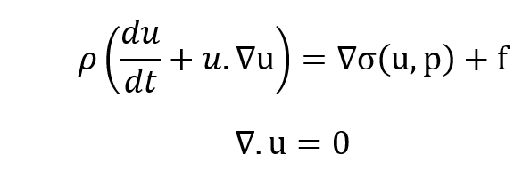
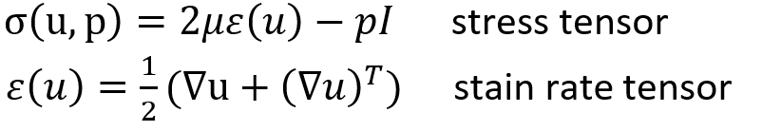
TITRE
PHYSICAL PROBLEM
u,p?
Navier Stokes :

Slide 3


TITRE
NEED OF THE USER
minimise the drag on the obstacle frontier
At each step, the user wants to know what is the form of the wingtip and why it is an amelioration
Information about pressure, velocity and the objective function
at each step

Slide 4
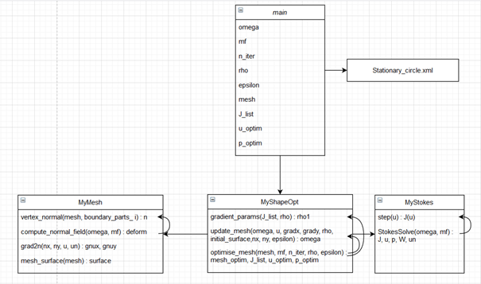
TITRE
GLOBAL ARCHITECTURE

Slide 5
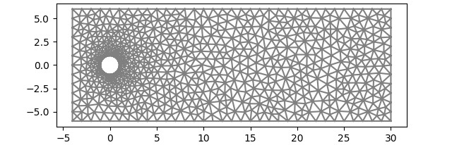
TITRE
COMPUTING THE PHYSICAL DOMAIN
Define a mesh for the space using the program gmsh:
A circle of radius 1 and center (0,0) drawn inside a rectangle of size [-4,30]x[-6,6].
This .msh file is then converted into a .xml file more compatible with FeniCS named “stationary_circle.xml

Slide 6
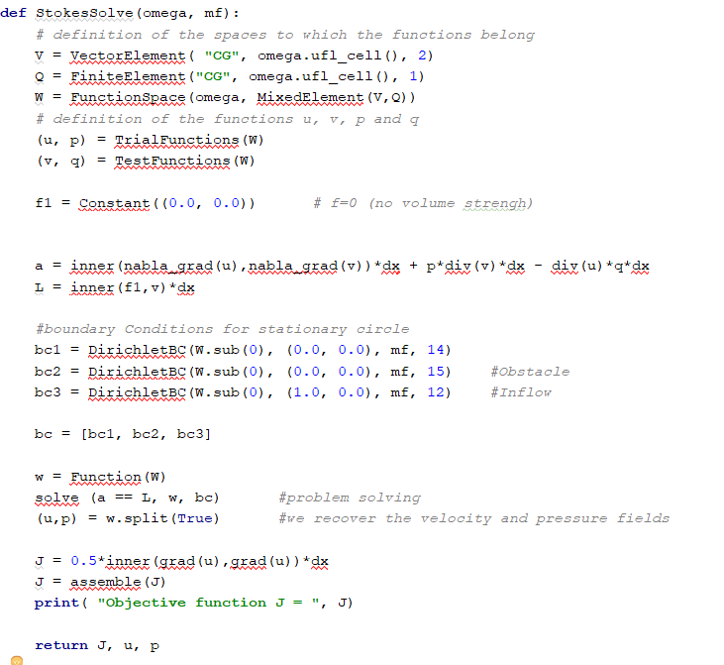
TITRE
SOLVING THE EQUATION
Variational formulation:

Slide 7
TITRE
SOLVING THE EQUATION

Slide 8
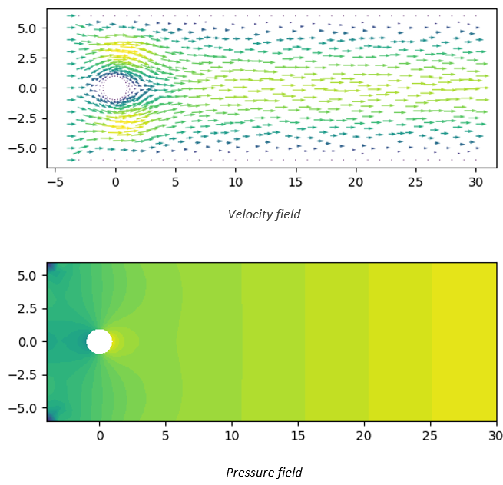
TITRE
SOLVING THE EQUATION
Seems to be in tune with physical properties:
pressure increases in amount of the obstruction
depression downstream of the obstable
speed slows down near the obstacle
edge conditions seems to be satisfied

Slide 9
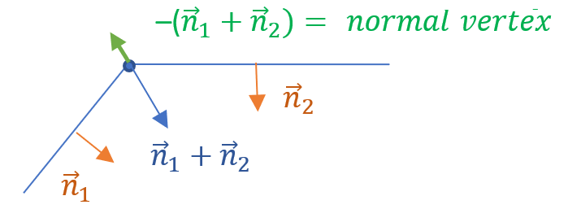
TITRE
CREATING A NORMAL FIELD OVER THE MESH

Slide 10
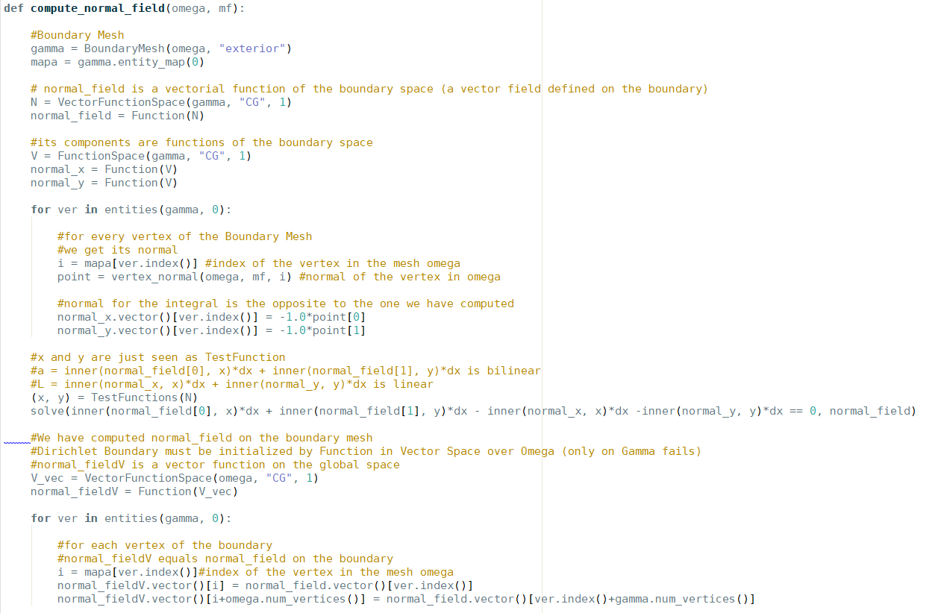
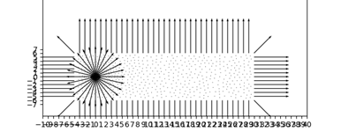
TITRE
CREATING A NORMAL FIELD OVER THE MESH

Slide 11
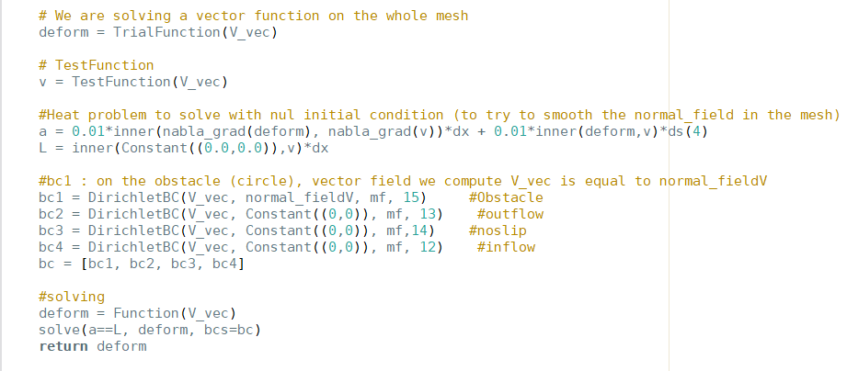
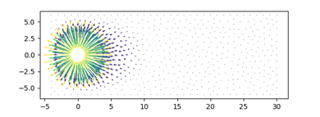
TITRE
CREATING A NORMAL FIELD OVER THE MESH

Slide 12
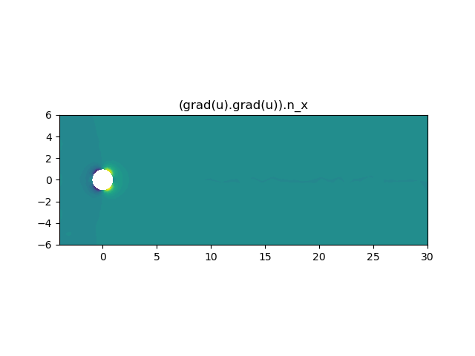
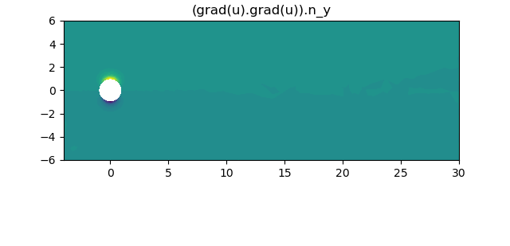
TITRE
GRADIENT FIELD OVER THE MESH

Slide 13
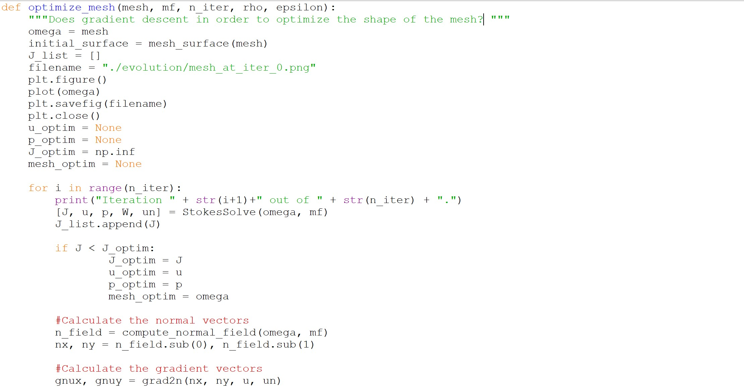
TITRE
OPTIMISING THE FORM OF THE MESH
Code to achieve the optimal form of the obstacle in order to minimize the function J(u):
n iterations for the cycle for:
each time J is compared with the previows
one
allowed only small variation per step
strain and density are kept constant

Slide 14
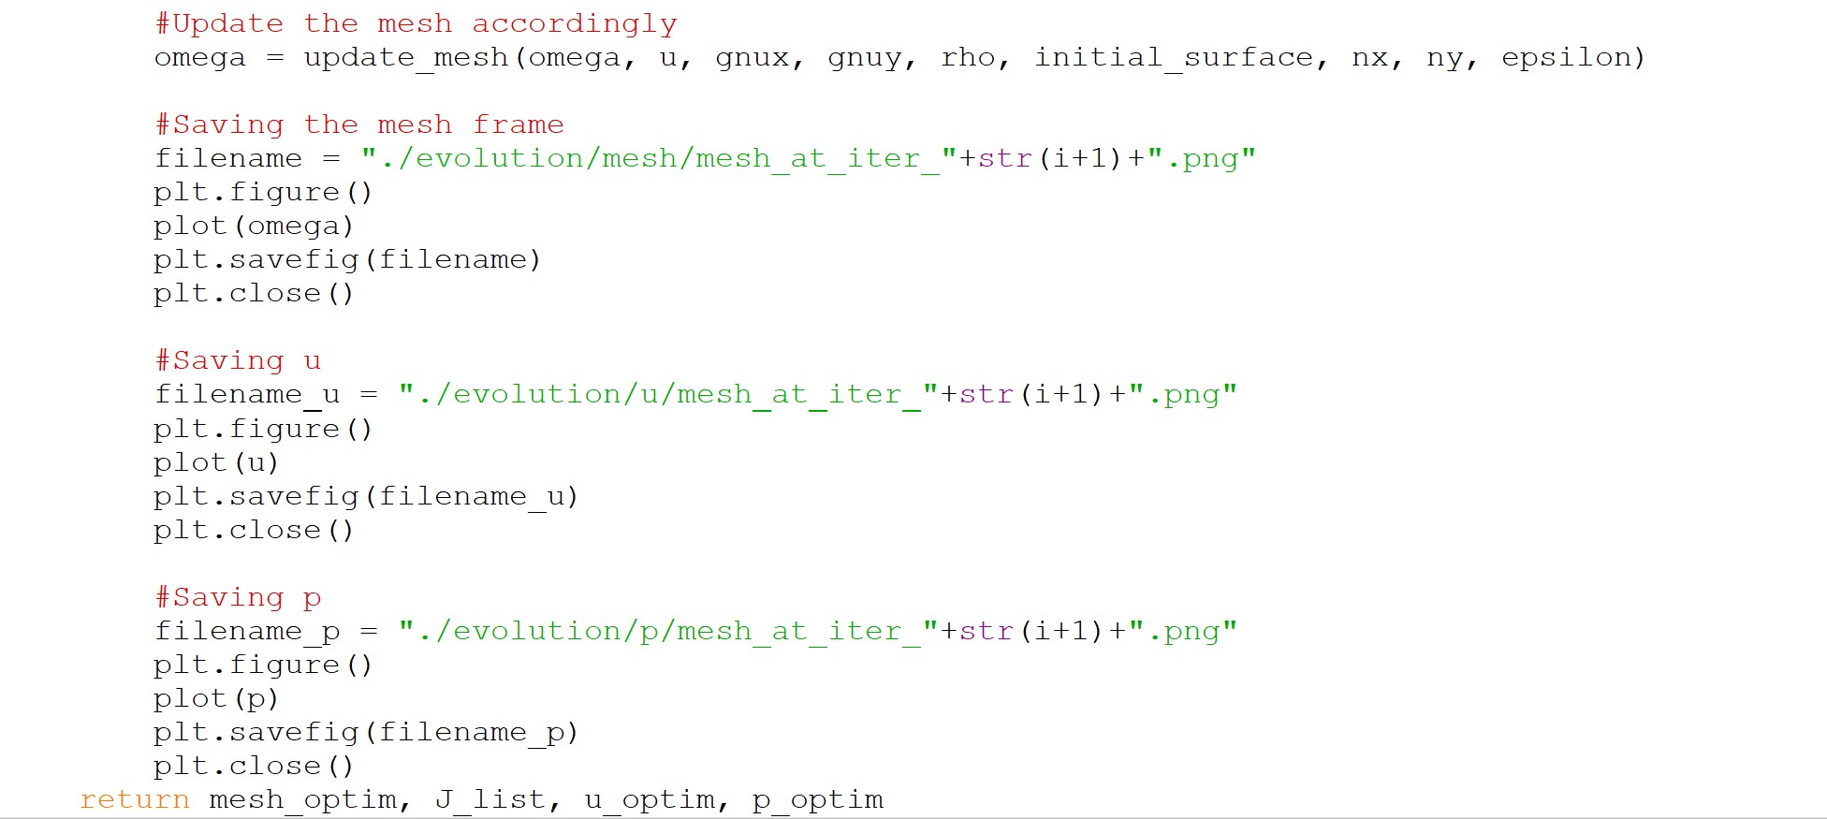
TITRE
OPTIMISING THE FORM OF THE MESH
Original mesh is taken as entry
and it’s modified at each iteration
with the function update_mesh
Current result is then saved

Slide 15
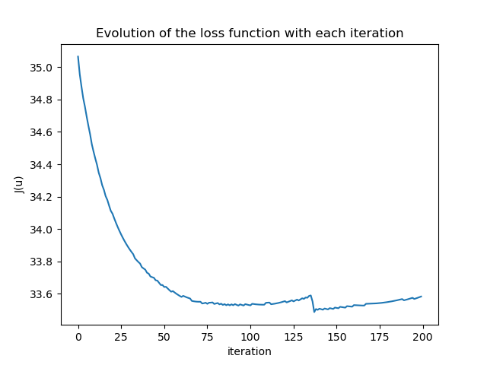
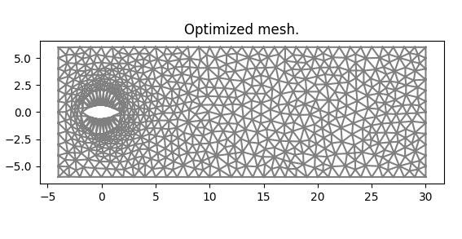
TITRE
RESULTS
At each step the mesh is updated and a new value for J(u) is found: ε = 0.01, ρ = 0.03

Slide 16
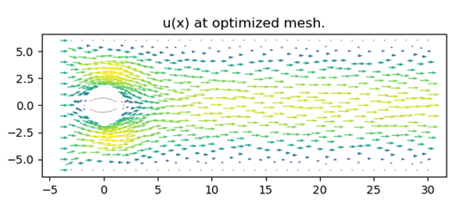
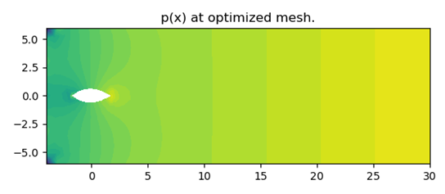
TITRE
RESULTS
Plot of p and u on the optimized mesh.

Slide 17
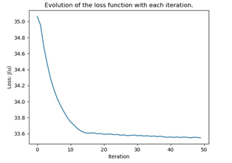
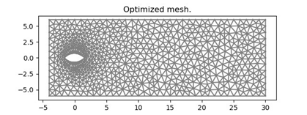
TITRE
RESULTS
At each step the mesh is updated and a new value for J(u) is found: ε = 0.01, variable rho

Slide 18
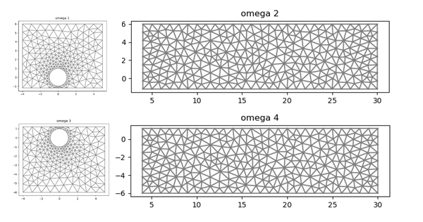
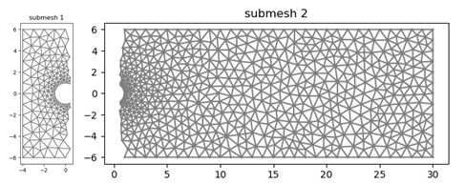
TITRE
PARALLELIZATION: GENERAL APPROACH
Meshes are generated in two ways:
Manually
Automatically

Slide 19
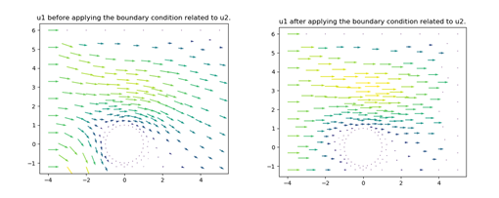
TITRE
PARALLELIZATION: GENERAL APPROACH
Optimization using Parallel Schartz Method.

Slide 20
TITRE
PARALLELIZATION: GENERAL APPROACH
Optimization using Parallel Schartz Method.
The mesh is divided into 4 sub-meshes.
Each sub-mesh is bound to a process.
Computation of the velocity and the normal fields
Communication using Ssend/Recv functions.

Slide 21
TITRE
PARALLELIZATION: FIRST VERSION
Implementation of the Schwarz Method in the previous sequential code
calculation of velocities and normal fields of each submesh
for each submesh, velocities at the border must correspond -> new velocity function is built
update the mesh and repeat for next step
same for vertices coordinates

Slide 22
TITRE
PARALLELIZATION: SECOND VERSION
MPI deployment of the parallel code:
Code is modified to be able to run on multiple nodes efficiently
We allocate nodes of the cloud (cluster cpusc72_1) and run the code with mpirun:
mpirun -np nbProcesses -map-by ppr:1:core -rank-by core -bind-to core python3 parallel.py

Slide 23
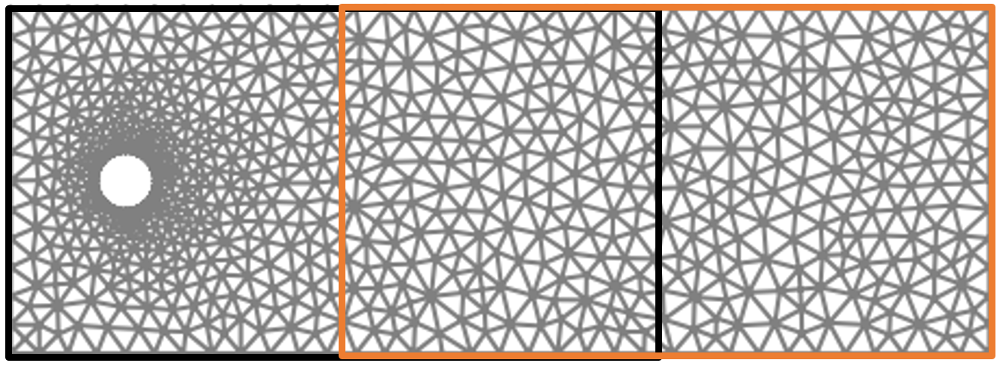
TITRE
PARALLELIZATION: FUTUR IMPROVEMENT

Slide 24
TITRE
CONCLUSIONS

